Slide 1


ONLINE FOOD ODERING PROCESS
THONDAPU SUCHARITHA 24KB1A04AD
PUTTAMANENI SWARNA 24KB1A04U4
GIDDALURU RAMYA MAHALAKSHMI 24KB1A04A3
VALIPI PRAVALLIKA 24KB1A04AV
PATHAN SALMA 24KB1A04S0
Bachelor Of Technology In
Electronics And Communication Engineering
Section :- D
Nbkrinstitute of science and technology
(an autonomous institute)
Vidyanagar – 524 413 Tirupati district ap

Slide 2
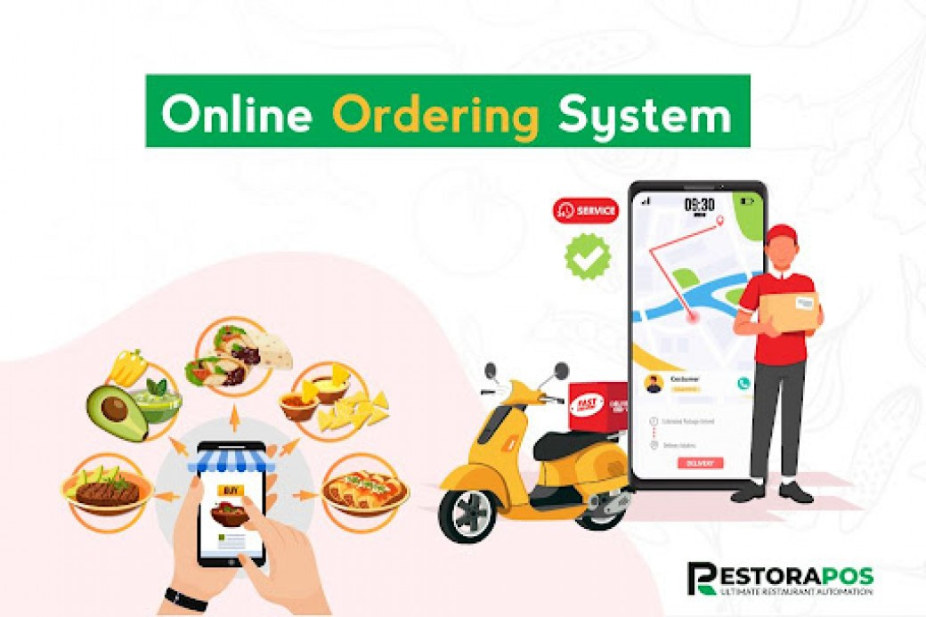
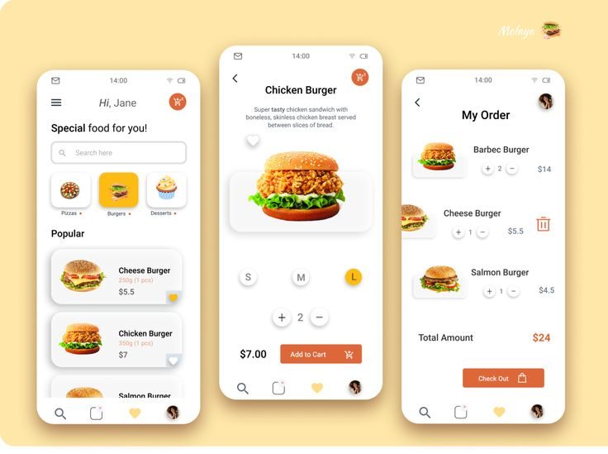
Introduction on project
In Today's Fast-paced Digital World, Online Food Ordering Systems Have Revolutionized The Way People Access And Enjoy Their Favorite Meals. These Systems Offer A Convenient Platform For Customers To Browse Restaurant Menus, Place Orders, And Make Payments—all From The Comfort Of Their Homes Or Workplaces. As The Demand For Contactless Services And Instant Gratification Continues To Grow, Such Systems Have Become Essential Tools For Both Customers And Food Service Providers. The Online Food Ordering System Is A Software Application Developed To Streamline The Food Ordering Process By Automating Various Tasks Such As Order Placement, Menu Management, And Order Tracking. It Bridges The Gap Between Restaurants And Customers By Offering A User-friendly Interface, Efficient Data Handling, And Real-time Order Processing. This System Not Only Enhances Customer Satisfaction But Also Helps Restaurants Manage Their Operations More Effectively, Reduce Human Errors, And Increase Revenue.

Slide 3
Previous projects
Console-based Online Food Ordering System
Online Food Ordering System With FileHandling
Multi-restaurant Food Ordering System
Admin & Customer Panel System

Slide 4
TECHNOLOGIES
Language: C
Data Structures: Arrays, Linked Lists
Features: Display Menu ,Take Orders , Generate Bill
Use Linked List To Store Multiple Orders Dynamically
Files: Single .C File With Menu Data Hardcoded.
Features: Register/Login Users , View And Edit Orders
Save And Load Menu And Order Data From .Txt Files
Files: Menu . Txt, Orders . Txt , Main .
Bonus: Use Of File Handling Functions Like Fopen() , Fscanf(), Fprintf()

Slide 5
Language: C Data Structures: Arrays, Linked Lists, Queues Features : Multiple Restaurants And Menus , Cart System Using Queues , Bill Generation , Delivery Tracking Modular Design: Separate Functions For Menu, Order, Delivery, Billing.
Language:- C
Data Structures: Structures, Linked List, Binary Search Tree (BST)
Features : Admin Panel To Add/Remove Menu Items
Customer Panel To Place/View Orders
Use Of BST For Fast Menu Searching

Slide 6
Disadvantages of previous system
1. Lack Of Built-in Networking Support : C Doesn't Have Native Libraries For Handling HTTP Requests Or Internet Protocols, Making It Hard To Implement Online Functionality Like Server-client Communication
.2. No GUI Support : C Is Not Suited For Creating User-friendly Graphical Interfaces Without External Libraries, Leading To Poor User Experience With Text-based Consoles
.3. Manual Memory Management : You Have To Handle Memory Allocation And Deallocation Manually, Which Increases The Risk Of Memory Leaks And Segmentation Faults
.4. Complexity In Handling Data : While Data Structures Like Linked Lists Or Trees Can Manage Data, Tasks Like Sorting, Searching, Or Managing Orders And Menus Become Complex And Error-prone Compared To Using Databases Or Higher-level Languages.
5. No Database Integration : C Doesn’t Offer Easy Integration With SQL Databases, Making Persistent Storage Of Users, Orders, And Food Items Difficult.
6. Security Vulnerabilities : C Is Prone To Buffer Overflows And Lacks Modern Encryption Libraries, Which Are Essential For Securing Payment And Personal Data.

Slide 7
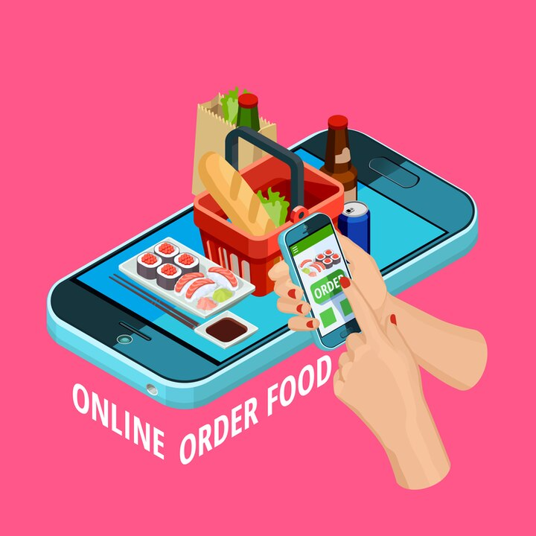
7. Poor Scalability : A C-based System Without Web Frameworks Or Apis Struggles To Scale Or Adapt To New Features Like Mobile Integration Or Online Payments 8. Limited Cross-platform Support : C Programs May Require Adjustments To Run On Different Operating Systems, Unlike Web-based Or Mobile Platforms.

Slide 8
Online food ordering system
An Online Food Ordering System Is A Software Application That Allows Customers To Order Food From Restaurants Or Food Service Providers Through The Internet. It Streamlines The Process Of Placing Food Orders, Reduces Manual Errors, And Improves Customer Convenience Key Features:
1. User Registration & Login – Secure Access For Users And Admins
2. Menu Display – Shows A List Of Food Items With Prices And Descriptions.
3. Add To Cart & Checkout – Allows Users To Select Multiple Items And Place Orders.
4. Order Management – Tracks Orders, Preparation, And Delivery Status.
5. Payment Integration – Accepts Online Payments (Optional For Simple Systems).
6. Admin Panel – Lets Admins Manage Menu Items, View Orders, And Update Statuses.

Slide 9
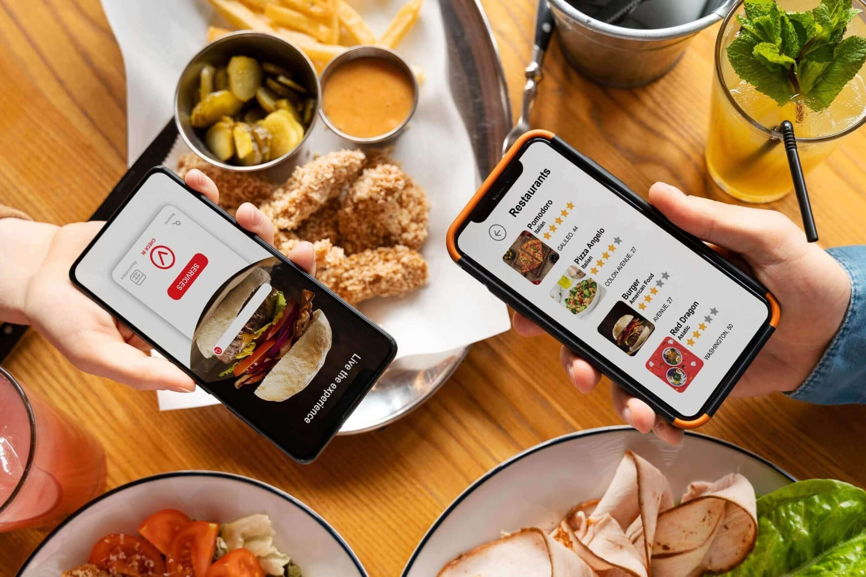
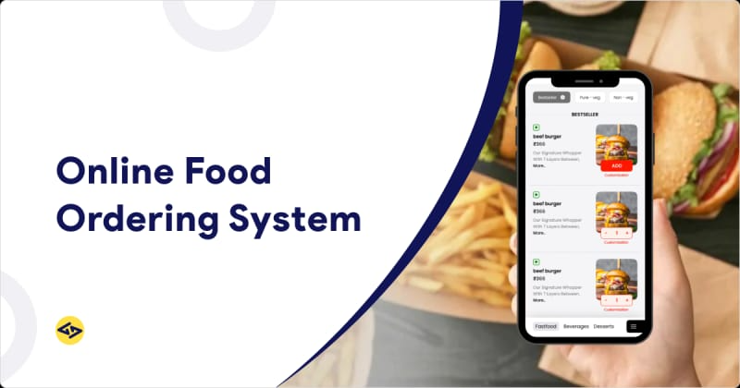
Benefits : Convenience For Customers To Order From Home. Efficiency In Handling Multiple Orders. Error Reduction Compared To Manual Ordering. Better Data Tracking For Business Insights.
Online food ordering system

Slide 10
Project development
Title: Online Food Ordering System – Project Development Report
1. Introduction :- Brief about the need for online food ordering Advantages over traditional ordering systems . Objectives of your project
2. Problem Statement :- Describe issues in manual food ordering processes . How the online system solves them.
3. Scope of the Project :- Who will use the system (e.g., customers, restaurant staff).Platform scope (web-based, mobile, etc.).
4. System Requirements :- Software: Language: C (with or without file handling)Compiler: GCC / Turbo COS: Windows/Linux Hardware: Minimum 2GB RAM500MB storage Intel processor or equivalent---
5. Modules Description :- Login/Registration Menu Display Order Placement BillingExit/Logout—
6. System Design :- Flowcharts or DFDs for logic . Description of user interface (text-based or GUI).Interaction between modules.---
7. Implementation :- Brief explanation of how each module is implemented in C . Key code snippets or logic

Slide 11
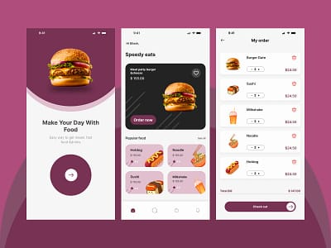
8. Output Screens :- Screenshots of the program output . Sample order placement and billing process.--- 9. Testing :- How the program was tested . Sample test cases and expected output.--- 10. Limitations :- No real-time data (in C, unless using advanced networking).Simple UI . No payment integration.--- 11. Future Enhancements :- Add database support (MySQL).Shift to web or mobile app . Add multiple restaurant support.--- 12. Conclusion :- Summary of what was achieved . Skills learned during development.

Slide 12
Modules
1. Menu Management
Purpose : Display Food Items, Prices, And Categories .
Data Structure : Array Or Linked List For Storing Food Items .
Struct For Item Details (Name, Price, Category).
Struct Food Item {
int id;
char name[50];
float price;
char category[30];
};
2. Order Placement System
Purpose: Take User Orders And Calculate Total.
Data Structure : Queue Or Linked List To Store Orders In Sequence.---

Slide 13
3. Customer Information System Purpose: Store and manage customer details (name, phone, address). Data Structure : Struct and linked list. 4. BILLING SYSTEM Purpose: generate and display bills with taxes, discounts. Data Structure : struct for bill data . Stack (optional) for undoing recent item additions.
5. ORDER HISTORY/TRACKING Purpose: maintain a history of past orders . Data Structure : file handling to store and retrieve order logs . Linked list for in-memory access

Slide 14
6. SEARCH FUNCTIONALITY Purpose: Search Food Items By Name Or Category. Data Structure : binary Search Tree (BST) Or Hash Table For Fast Search. 7. SORTING ITEMS Purpose: Sort Menu By Price, Name, Or Rating. Data Structure : sorting Algorithms On Arrays Or Linked Lists (E.G., Quick Sort, Merge Sort).
8. ADMIN PANEL Purpose: Add/Delete/Update Food Items, View Sales Reports. Data Structure : linked Lists Or Arrays . File Handling For Permanent Changes.

Slide 15
Advantages of online food ordering
1.Convenience: Customers Can Browse Menus, Place Orders, And Make Payments From Anywhere, At Any Time.
2. Time-saving: Ordering Food Online Is Faster Than Traditional Methods Like Phone Calls Or In-person Visits.
3.Wider Reach For Restaurants: Restaurants Can Attract More Customers Beyond Their Immediate Locality.
4.Order Accuracy: Reduces Human Error As Orders Are Placed Digitally By Customers Themselves.
5.Increased Efficiency: Streamlines Operations For Restaurants By Managing Orders, Inventory, And Delivery Logistics More Effectively.

Slide 16
6. Data And Analytics: Enables Restaurants To Collect Customer Data For Targeted Marketing, Trend Analysis, And Improving Services. 7.Multiple Payment Options: Offers Flexibility With Digital Wallets, Credit/Debit Cards, And Cash On Delivery
8. Improved Customer Experience: Features Like Order Tracking, Reviews, And Loyalty Rewards Enhance Satisfaction.
9. Cost-effective Marketing: Promotions And Discounts Can Be Easily Managed Through The Platform.10. Environmentally Friendly: Reduces Paper Usage Through Digital Receipts And Menus.

Slide 17
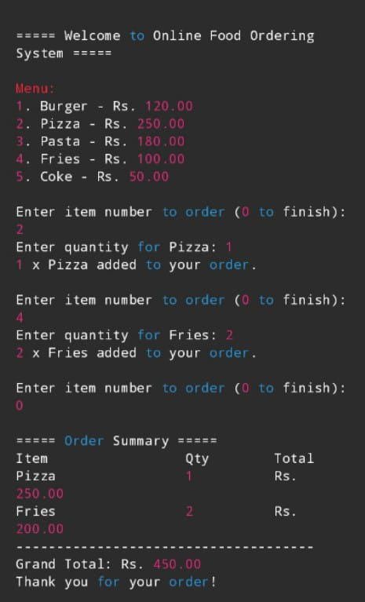
Output image

Slide 18
conclusion
The Online Food Ordering System Significantly Streamlines The Food Ordering Process By Offering A Convenient, Efficient, And User-friendly Platform For Both Customers And Restaurant Administrators. Through The Implementation Of Core Modules Such As Menu Browsing, Order Placement, Billing, And User Management, The System Demonstrates How Automation Can Reduce Manual Errors, Enhance Customer Satisfaction, And Improve Overall Business Operations .
This Project Highlights The Practical Application Of C Programming In Developing Real-world Systems, Emphasizing Modular Design, File Handling, And User Interaction. While The Current System Provides Essential Functionality, It Also Lays The Foundation For Future Enhancements Such As Online Payment Integration, Delivery Tracking, And A Graphical User Interface .
Overall, The Project Successfully Meets Its Objectives And Serves As A Robust Base For Further Development Into A Full-featured Commercial Application.

Slide 19
THANK YOU

